Slide 1
Regression

Slide 2
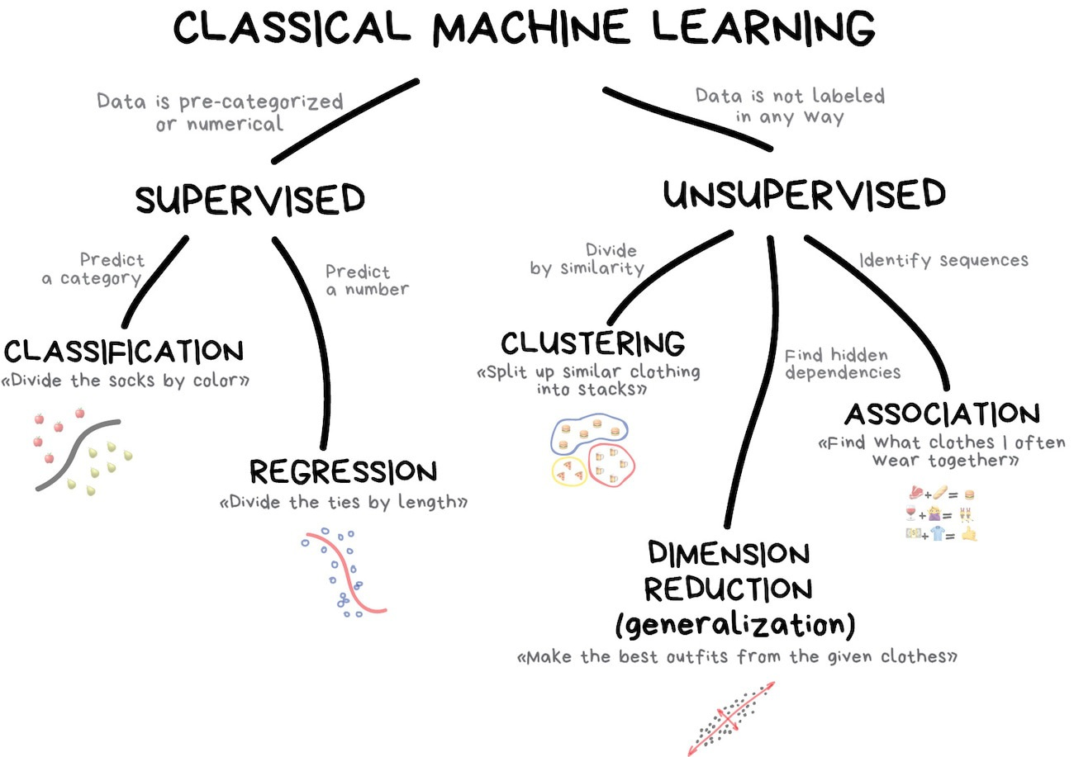

Slide 3
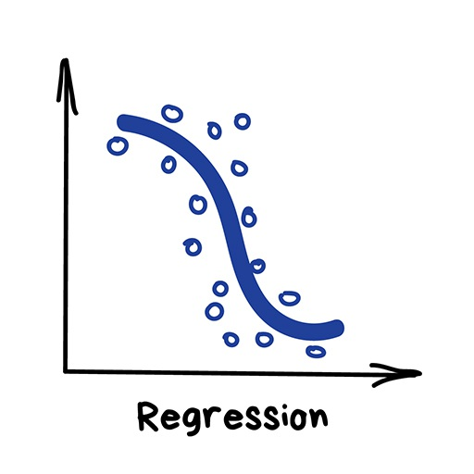
Regression
"Draw a line through these dots”
Today this is used for:
Stock price forecasts
Demand and sales volume analysis
Medical diagnosis
Any number-time correlations
House price prediction
Flight price prediction
…

Slide 4
Motivation
One of the most widely used techniques
Easy to interpret
Efficient to solve

Slide 5
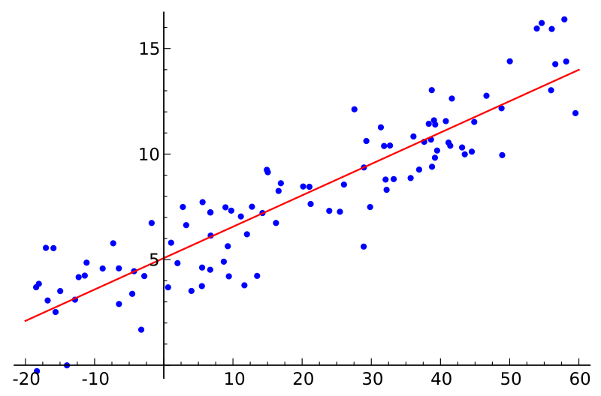
Simple Linear Regression
Y
X
Response
Variable
Covariate
Linear Model:
Slope
Intercept (bias)

Slide 6
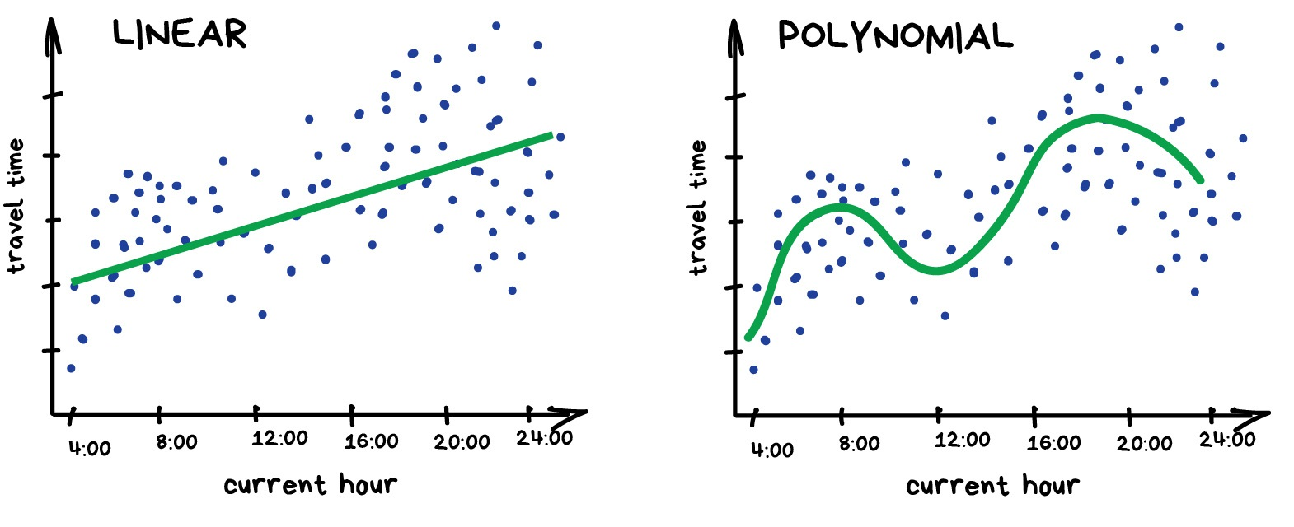
Regression

Slide 7
Regression
Everyone who works with finance and analysis loves regression.
It's even built-in to Excel. And it's super smooth inside — the machine simply tries to draw a line that indicates average correlation.

Slide 8
Regression Analysis…
Our objective is to analyze the relationship between interval variables;
Regression analysis is used to predict the value of one variable (the dependent variable) on the basis of other variables (the independent variables).
Dependent variable: denoted Y
Independent variables: denoted X₁, X₂, …, X_{k}

Slide 9
Regression Analysis…
If we are interested only in determining whether a relationship exists, we may employ correlation analysis.
Regression analysis with two-variables is sometimes called simple linear regression.
Mathematical equations describing their relationships are also called models
2 types: deterministic or probabilistic.

Slide 10
Model Types…
Deterministic Model: an equation or set of equations that allow us to fully determine the value of the dependent variable from the values of the independent variables.
Contrast this with…
Probabilistic Model: a method used to capture the randomness that is part of a real-life process.
E.g. do all houses of the same size (measured in square feet) sell for exactly the same price?

Slide 11
A Model…
To create a probabilistic model, we start with a deterministic model that approximates the relationship we want to model and add a random term that measures the error of the deterministic component.
Deterministic Model:
The cost of building a new house is about $75 per square foot and most lots sell for about $25,000.
Hence the approximate selling price (y) would be:
y = $25,000 + (75$/ft²) * x
(where x is the size of the house in square feet)

Slide 12
Regression Analysis…
Our objective is to analyze the relationship between interval variables;
Regression analysis is used to predict the value of one variable (the dependent variable) on the basis of other variables (the independent variables).
Dependent variable: denoted Y
Independent variables: denoted X₁, X₂, …, X_{k}

Slide 13
A Model…
A model of the relationship between house size (independent variable) and house price (dependent variable) would be:
House
Price:
Y
Building a house costs about
$75 per square foot.
House Price = 25000 + 75 * Size
Most lots sell
for $25,000
House size: X
In this model, the price of the house is completely determined by the size.

Slide 14
A Model…
In real life however, the cost of houses will vary, even among for houses of the same size:
Lower vs. Higher
Variability
House
Price:
Y
25K$
House Price = 25,000 + 75*Size +
x
House size: X

Slide 15
Random Term…
We now represent the price of a house as a function of its size in this Probabilistic Model:
y = 25,000 + 75x + ,
where (Greek letter epsilon) is the random term (a.k.a. error variable).
It is the difference between the actual selling price and the estimated price based on the size of the house (model based price) .
Its value will vary from house sale to house sale, even if the square footage (i.e. x) remains the same.

Slide 16

Simple Linear Regression Model…
Generally, a straight line model with one independent variable is called a simple linear regression model.
dependent
variable
independent
variable
y-intercept
slope of the line
error term

Slide 17


Simple Linear Regression Model…
Note that both and are population parameters which are usually unknown and hence estimated from the data.
y
rise
run
=slope (=rise/run)
=y-intercept
x

Slide 18
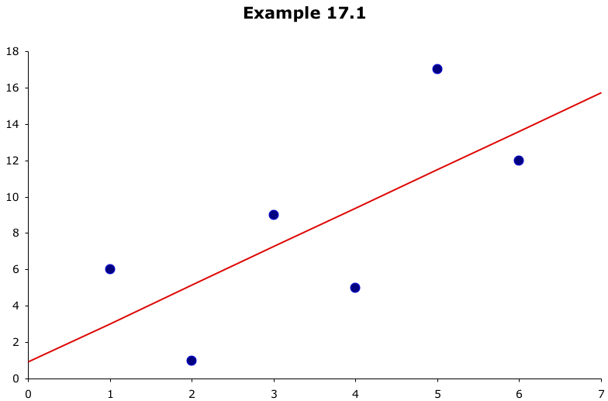
Which line has the best “fit” to the data?
?
?
?

Slide 19



Estimating the Coefficients…
In much the same way we based estimates of on , we estimate from b₀ and from b₁, the y-intercept and slope (respectively) of the least squares or regression line given by:
(Recall: this is an application of the least squares method and it produces a straight line that minimizes the sum of the squared differences between the points and the line)

Slide 20
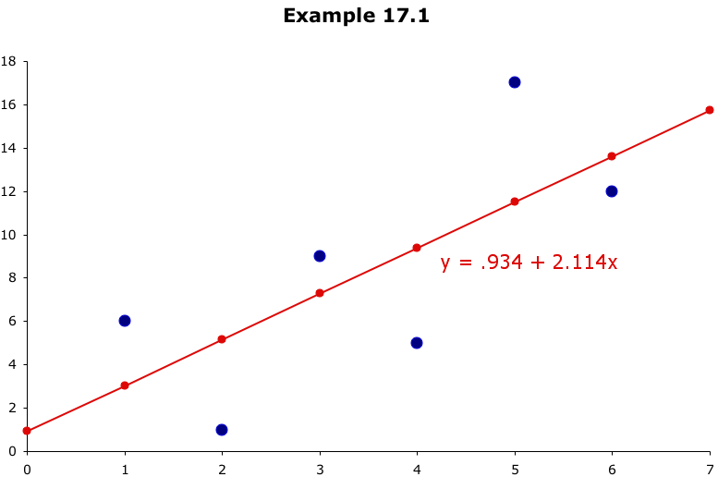
Least Squares Line…
these differences are called residuals
This line minimizes the sum of the squared differences
between the points and the line…
…but where did the line equation come from?
How did we get .934 for a y-intercept and 2.114 for slope??

Slide 21
Mathematical Optimization Routine (Optional)

Slide 24
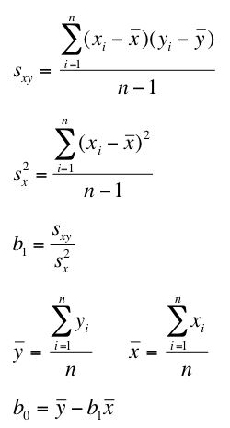
Least Squares Line…
The coefficients b₁ and b₀ for the least squares line…
…are calculated as:

Slide 25
Least Squares Line…
Statistics
Recall…
Data
Information
Data Points:
x | y
1 | 6
2 | 1
3 | 9
4 | 5
5 | 17
6 | 12
y = .934 + 2.114x

Slide 26
Excel
Insert – Scatter
Right click on data point – add trend line (linear)
Tick on add equation and add R^2
x | y
1 | 6
2 | 1
3 | 9
4 | 5
5 | 17
6 | 12

Slide 27
Least Square Line …
Exercise (optional) : Decide which of these equations fits the given data best.
MJT = Mean January Temperature
LAT = Latitude
A: MJT’ = 100 -1.8 (LAT)
B: MJT’ = 108 - 2.1 (LAT)
C: MJT’ = 115 – 2.5 (LAT)
City | MJT | LAT
Boise | 22 | 43.7
Philly | 24 | 40.9
Milwaukee | 13 | 43.3

Slide 28
Model Comparison
Model predictions:
Lat (x) | A (y’) | B (y’) | C (y’) | MJT (y)
43.7 | 21.34 | 16.23 | 5.75 | 22
40.9 | 26.38 | 22.11 | 12.75 | 24
43.3 | 22.06 | 17.07 | 6.75 | 13
 | MJT-MJT_A | MJT-MJT_B | MJT-MJT_C
 | 0.66 | 5.77 | 16.25
 | -2.38 | 1.89 | 11.25
 | -9.06 | -4.07 | 6.25
Sum: | -10.78 | 3.59 | 33.75
 | (MJT-MJT_A)^2 | (MJT-MJT_B)^2 | (MJT-MJT_C)^2
 | 0.4356 | 33.2929 | 264.0625
 | 5.6644 | 3.5721 | 126.5625
 | 82.0836 | 16.5649 | 39.0625
Sum^2: | 88.1836 | 53.4299 | 429.6875

Slide 29
A Simple Linear Regression Model
It models the relationship between X and Y as a straight line.
We have seen this earlier as a least squares line.
Values of X are assumed fixed, i.e. not random.
The only randomness in the model comes from ε, the error term.
Assume: ε ~ N(0, σ)

Slide 30
A Simple Linear Regression Model
Population Model: The Estimated Model:
Y= β₀ + β₁X + ε Y’ = b₀ + b₁X
Y is the value of the dependent variable
β₀ is the population (true) Y-intercept
β₁ is the population (true) slope coefficient
X is any selected value of the independent variable
ε is the “error” term
Y’ is the predicted value of Y|X
b₀ is the predicted Y-intercept
b₁ is the predicted slope of the line

Slide 31
How Well Does the Model Fit?
We would like Y and Y’ to be as close to one another as possible (or the difference between Y and Y’ to be as small as possible).
In Fact, we want ALL the differences-squared ADDED UP to be as small as possible.
The sum of all total differences are called the Sum of Squared Errors or SSE.
a. (Y - Y’) = e, the estimated error, or residual.
b.
c. Aggregate measure of how much the predicted Y’s differ from the actual Y’s.
d. The bs minimizing SSE construct the Least Square Line.

Slide 32
How Well Does the Model Fit?
SST = SSR + SSE
The total variation (Total Sum of Squares: SST) of the dependent variable can be divided into:
The variation explained by the model (Sum of Squares for Regression: SSR) and
The variation unexplained (Sum of Squared Error: SSE).
We measure the variation around the mean, Ybar.

Slide 33
SST = SSR + SSE
y
x

Slide 34
Coefficient of Determination (R²)
SSE - Sum of Squared Error
SSR - Sum of Squares for Regression
SST – Total Sum of Squares

Slide 35
Coefficient of Determination (R²)
The proportion of the deviation of Y from its mean in the sample that is explained by the regression.
It is always between 0 and 1.
The closer to 1, the better is the fit.
It happens also to be the correlation squared: where is the correlation coefficient
It is the most commonly used measure of the “fit” of a regression.

Slide 36

Standard Error of Estimation
The sum of squares for error is calculated as:
and is used in the calculation of the standard error of estimate:
If is zero, all the points fall on the regression line.

Slide 37
Example
A used car dealer recorded the price (in $1,000’s) and odometer reading (also in 1,000s) of 100 three-year old Ford Taurus cars in similar condition with the same options.
Can we use data to find a regression line?

Slide 38
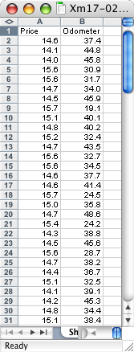
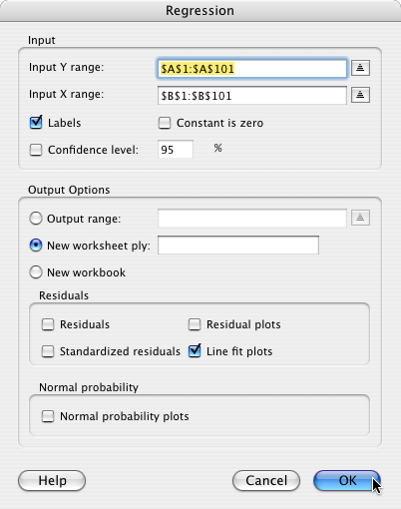
Example
COMPUTE
Tools >
Data Analysis… >
Regression
Y range (price)
X range (odometer)
OK
Check this if you want a scatter plot of the data…

Slide 39
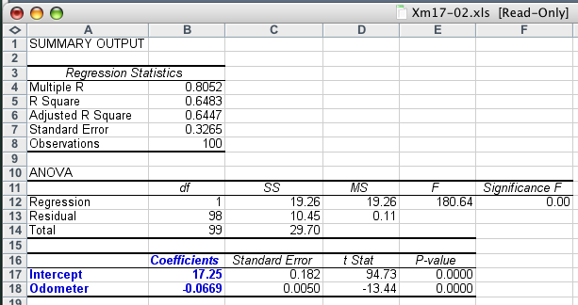

Example
Lots of good statistics calculated for us, but for now, all we’re interested in is this…

Slide 40
Example
As you might expect with used cars…
The slope coefficient, b₁, is –0.0669, that is, each additional mile on the odometer decreases the price by $0.0669 or 6.69¢
The intercept, b₀, is 17,250. One interpretation would be that when x = 0 (no miles on the car) the selling price is $17,250.
However, we have no data for cars with less than 19,100 miles on them so this isn’t a correct assessment.

Slide 41
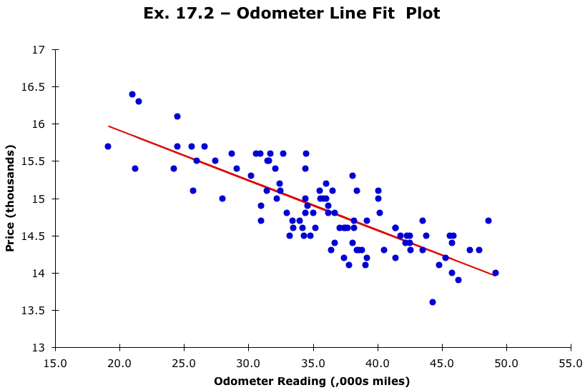
Example
Selecting “line fit plots” on the Regression dialog box, will produce a scatter plot of the data and the regression line…

Slide 42
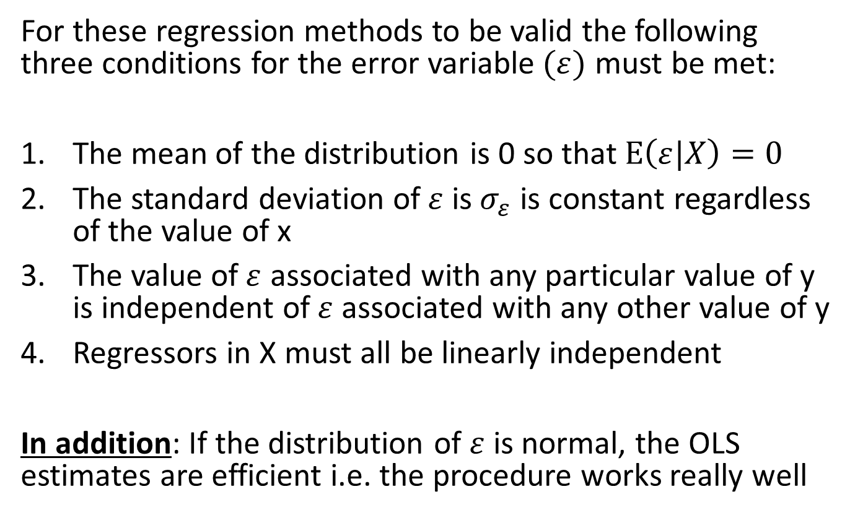
Required Conditions for OLS
For these regression methods to be valid the following three conditions for the error variable$(ε)$ must be met:
The mean of the distribution is 0 so that $E\left(ε|X\right)=0$
The standard deviation of$ε$ is${ σ}_{ε}$ is constant regardless of the value of x
The value of$ε$ associated with any particular value of y is independent of$ε$ associated with any other value of y
Regressors in X must all be linearly independent
In addition: If the distribution of $ε$ is normal, the OLS estimates are efficient i.e. the procedure works really well

Slide 43
Coefficient of Determination
R² has a value of 0.6483. This means 64.83% of the variation in the auction selling prices (y) is explained by the variation in the odometer readings (x).
The remaining 35.17% is unexplained, i.e. due to error.
In general the higher the value of R², the better the model fits the data.
R² = 1: Perfect match between the line and the data points.
R² = 0: There are no linear relationship between x and y.

Slide 44
Example
Data
x | y
1 | 6
2 | 1
3 | 9
4 | 5
5 | 17
6 | 12

Slide 45
Example
x | y
1 | 6
2 | 1
3 | 9
4 | 5
5 | 17
6 | 12
Tools >
Data Analysis… >
Regression
Y range
X range
Regression Statistics
Multiple R | 0.700695581
R Square | 0.490974298
Adjusted R Square | 0.363717872
Standard Error | 4.502909113
Observations | 6
 | Coefficients | Standard Error | t Stat | P-value
Intercept | 0.933333333 | 4.19198025 | 0.222647359 | 0.834716871
x | 2.114285714 | 1.076401159 | 1.96421724 | 0.120968388

Slide 46

Testing the significance of the slope coefficients…
We can test to determine whether there is enough evidence of a linear relationship between variable X and the dependent variable Y for the entire population
H₀: = 0 (no effect, or insignificant)
H₁: ≠ 0 (significant)
for i = 1 and using:
as our test statistic (with n–i–1 degrees of freedom).

Slide 47
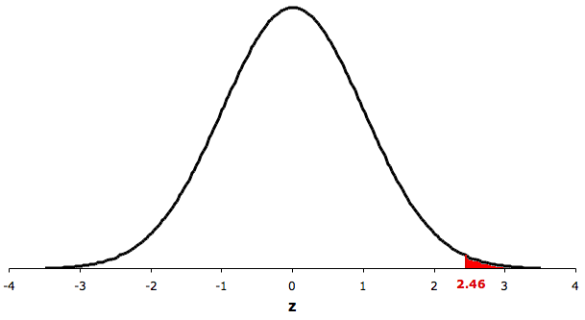
P-value of slope coefficient of income
Since the p-value is larger than α, we fail to reject H0.
We conclude that slope coefficient is not significantly different from zero.
p-value = 2*P(T>1.196) =
= 2*tdist(1.96,4,1) = 0.12
Degrees of freedom: 6-1-1=4
α/2=0.025
α/2=0.025
p-value/2 =0.06
t
t_{.025}=-2.78
H0: b1 = 0
t_{.025}=abs(t.inv(0.05,4)) =2.78
t =1.96

